Slide 1


Slide 2
Port Royal Beach Co. Progress Timeline
Winter 2021:
Safe Harbor asks TBC to visit site for the 1st time
TBC/Port Royal Staff/Safe Harbor hold 1st introduction meeting
Summer 2021:
TBC Assists Safe Harbor with Dev. Agreement Amendments + Land Closing
TBC begins to underwrite and pursue all residential components
Fall 2022:
TBC revises plans to The Bluff Village and The Ribaut Village (For Sale to For Rent)
Winter 2022:
TBC revises plans to solely The Bluff Village to a Single-Family Rental (SFR) concept only
TBC receives early indications of environmental conditions in multiple locations + site work impacts from Safe Harbor
Spring 2023:
TBC receives confirmation of environmental conditions, topography and estimated cost impacts
TBC revises plans to The Bluff Village from just SFR, to SRF and Townhomes
Summer 2023:
TBC in active design of and pricing of The Bluff Village to SFR and Townhomes (*current plans in DRAFT form)

Slide 3
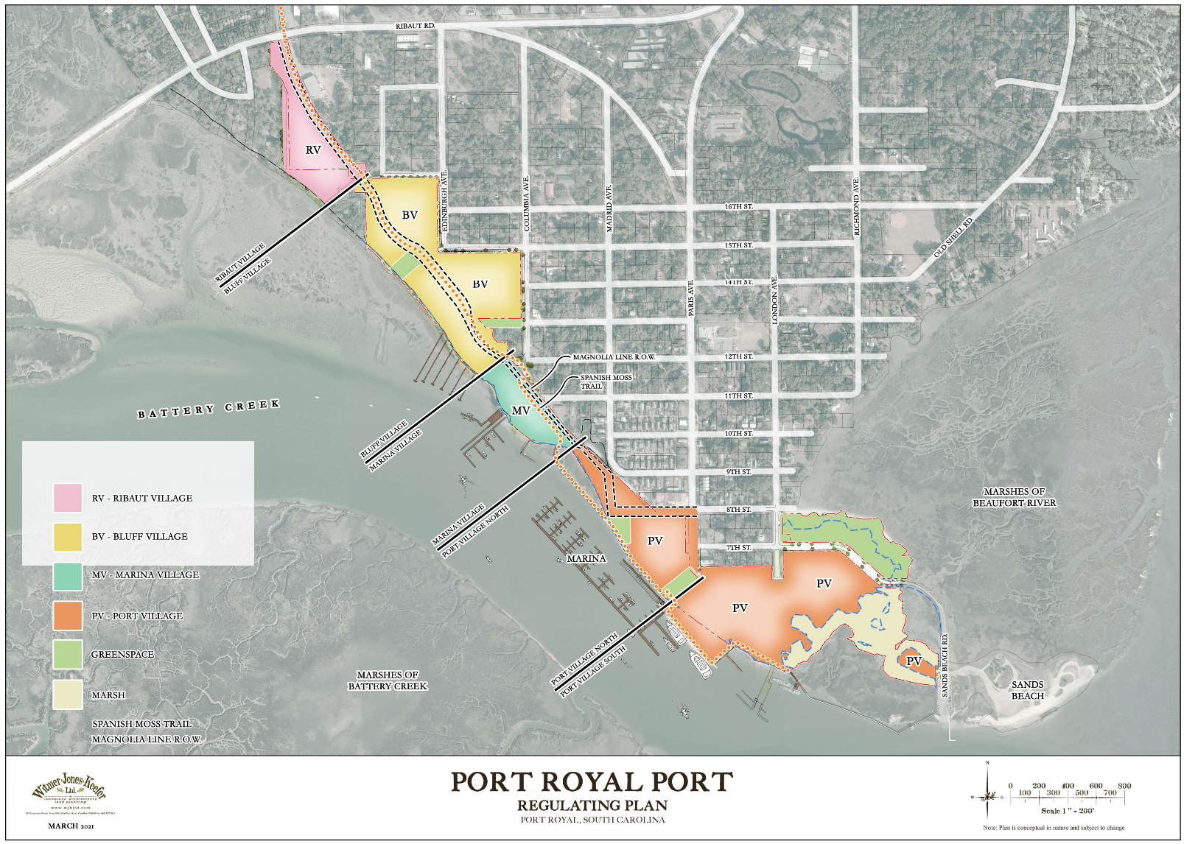

Slide 4
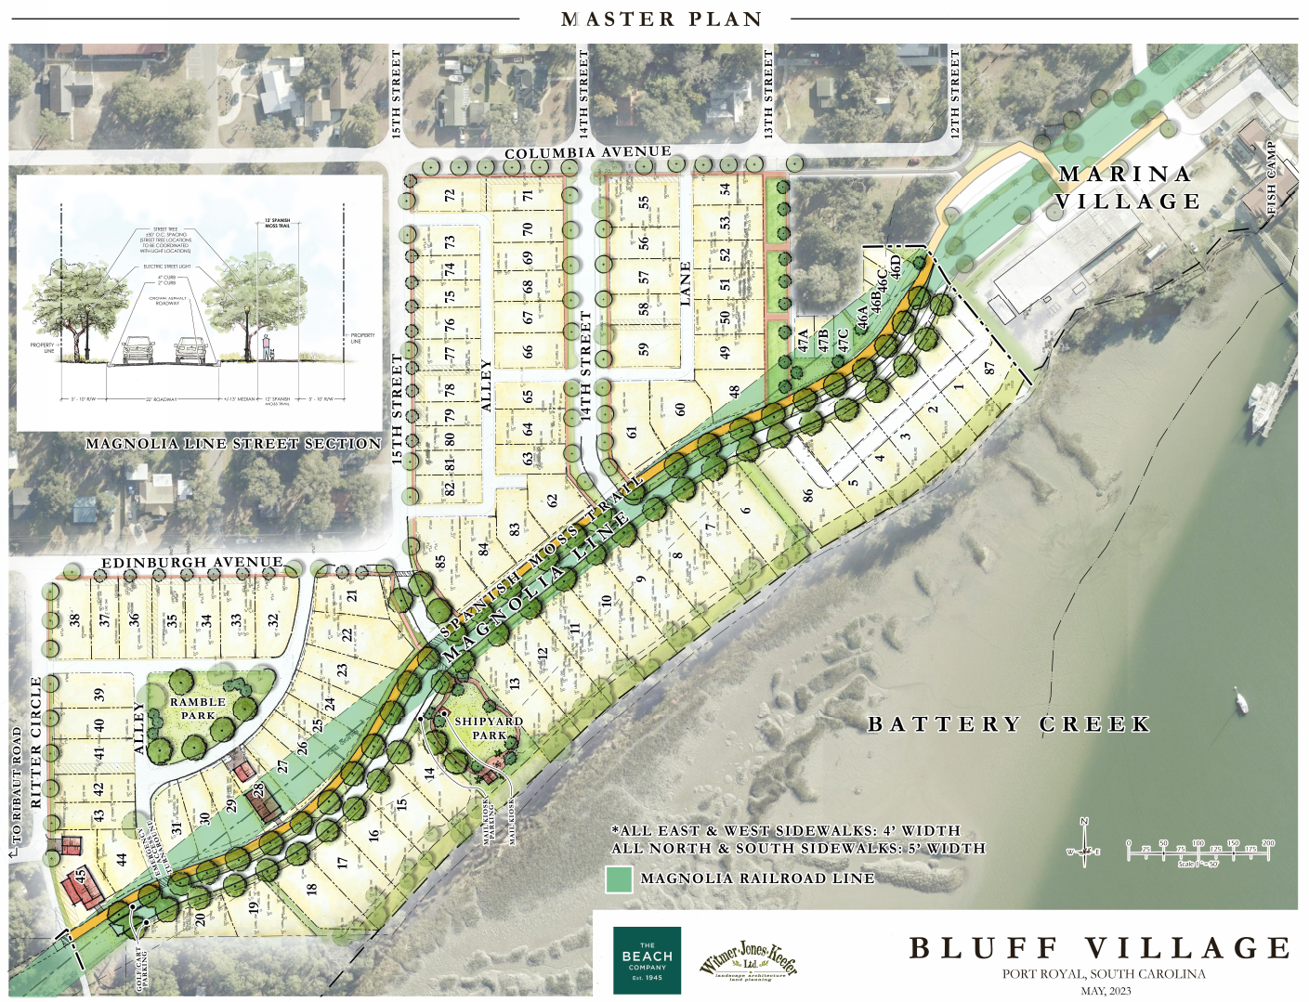

Slide 5
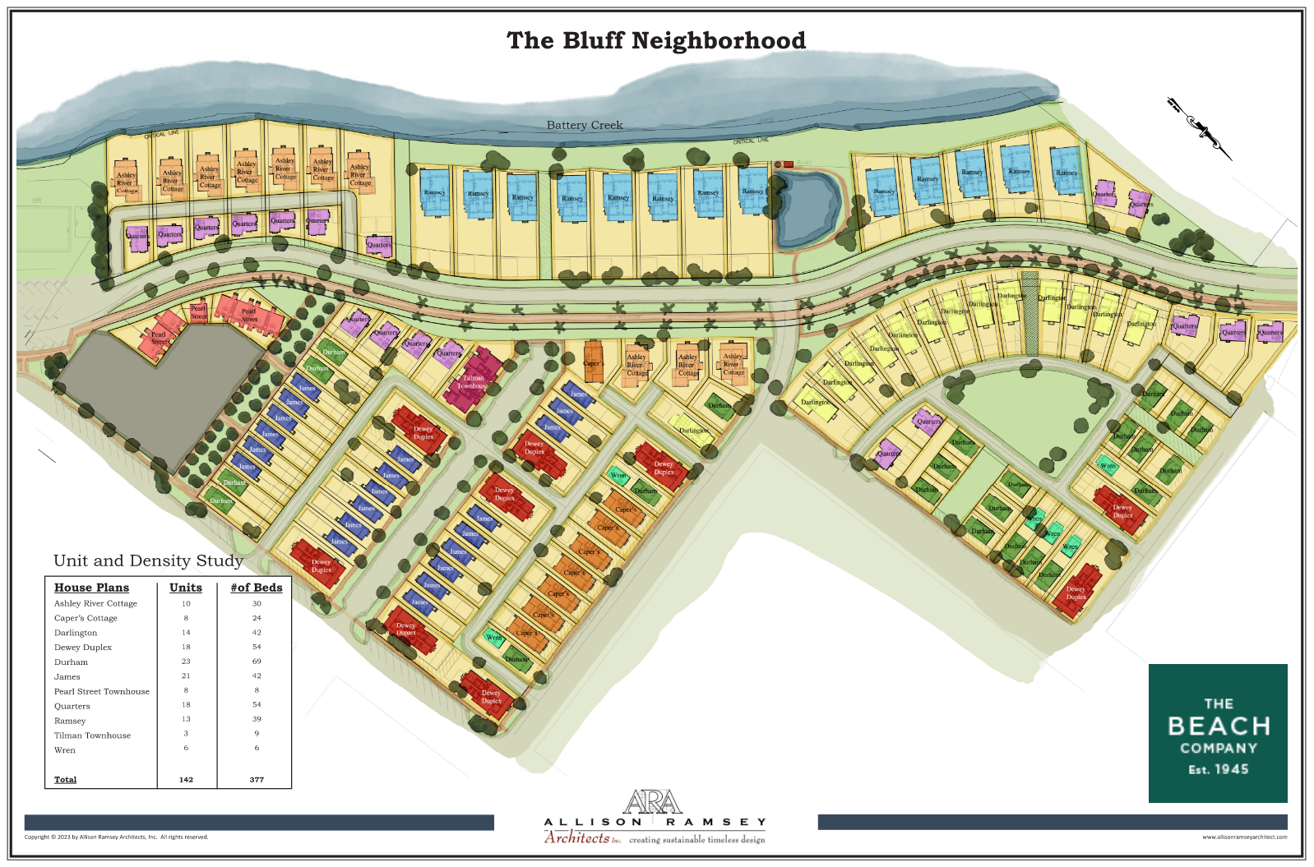

Slide 7
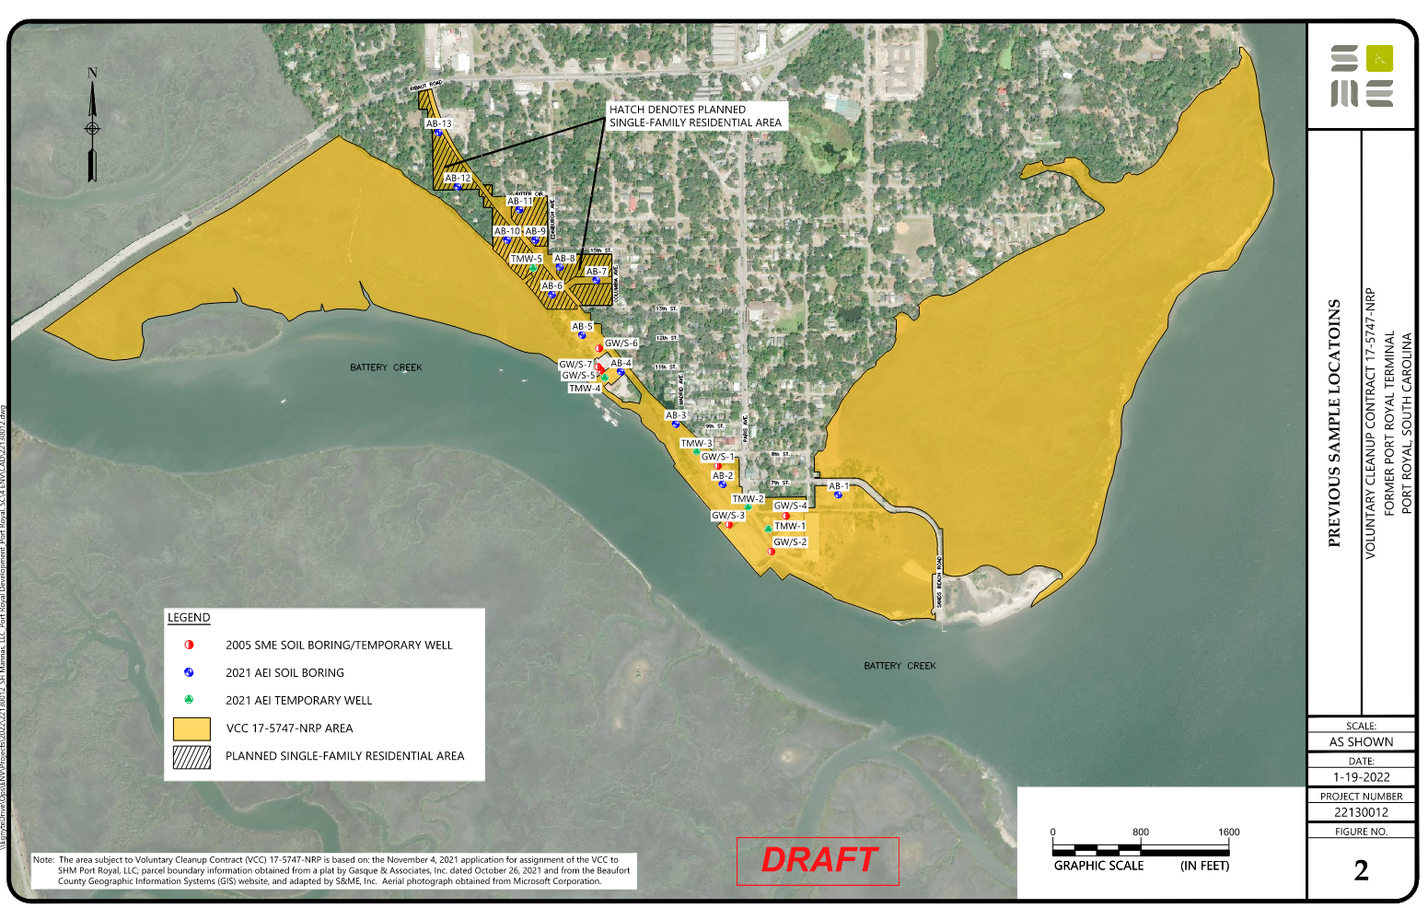

Slide 8









Slide 9
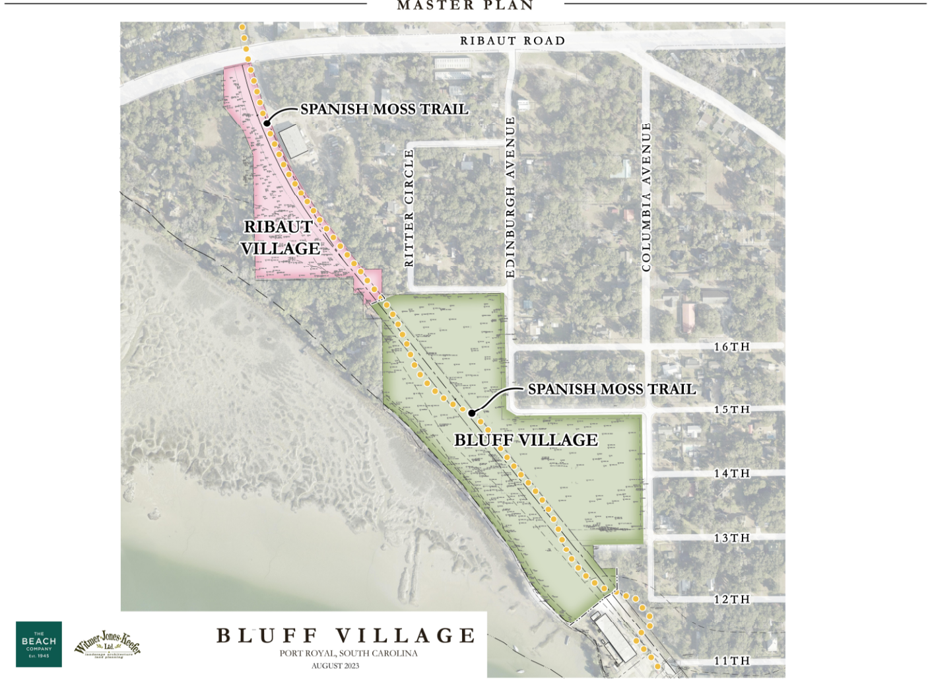

Slide 10
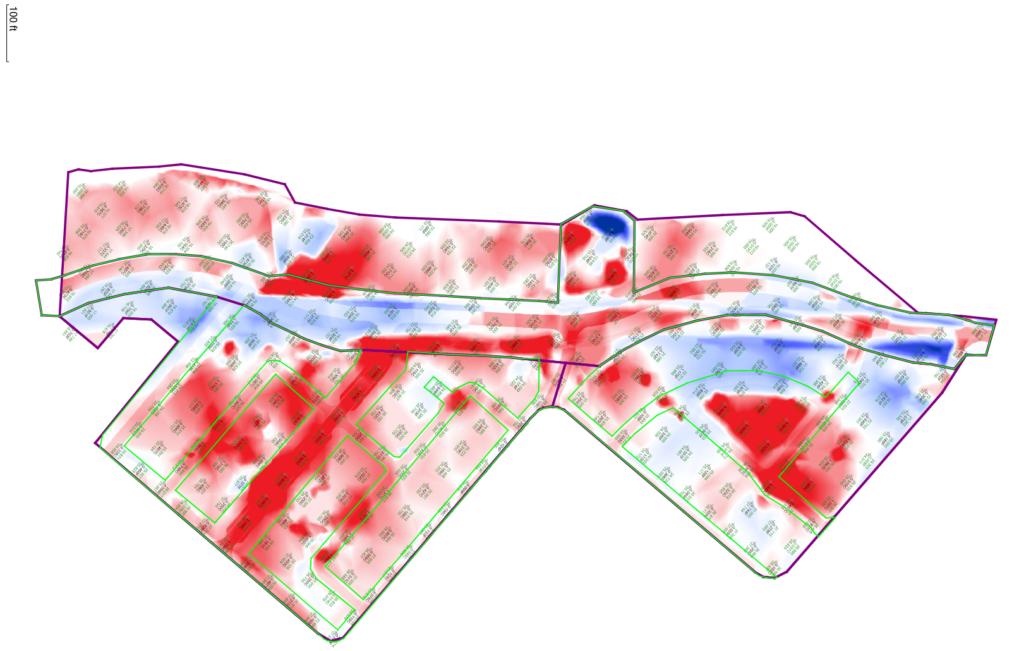


Slide 11
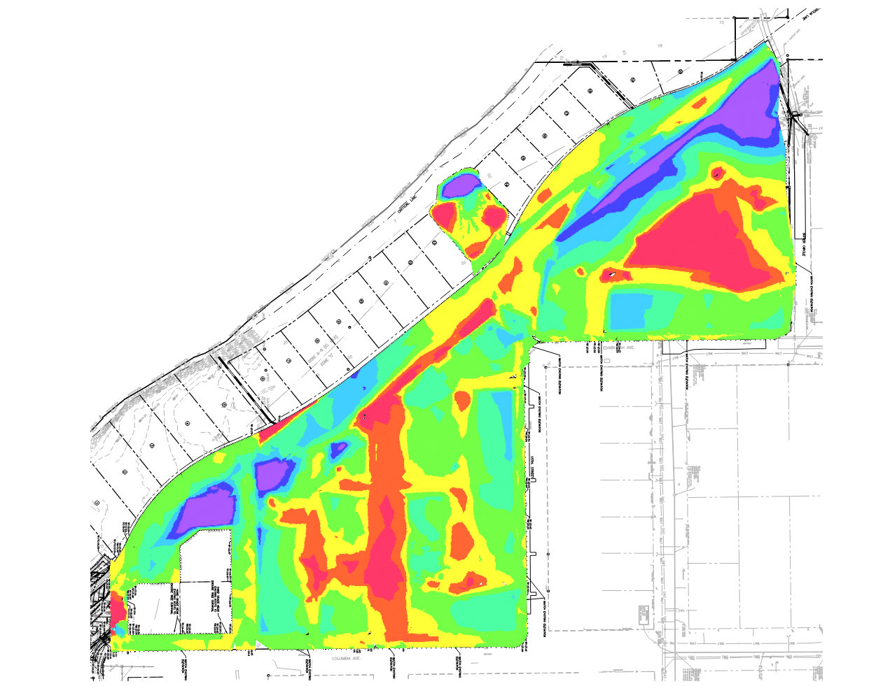


Slide 12
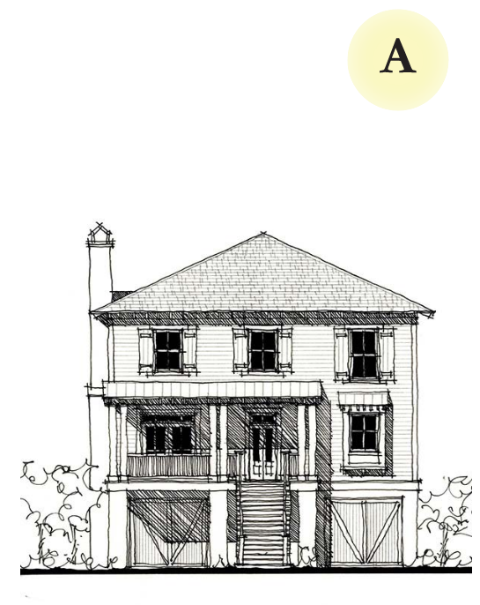
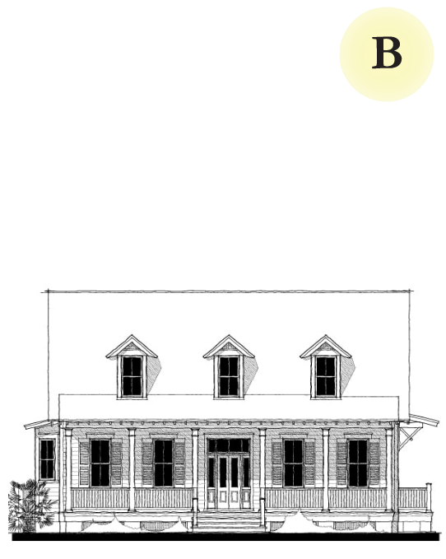
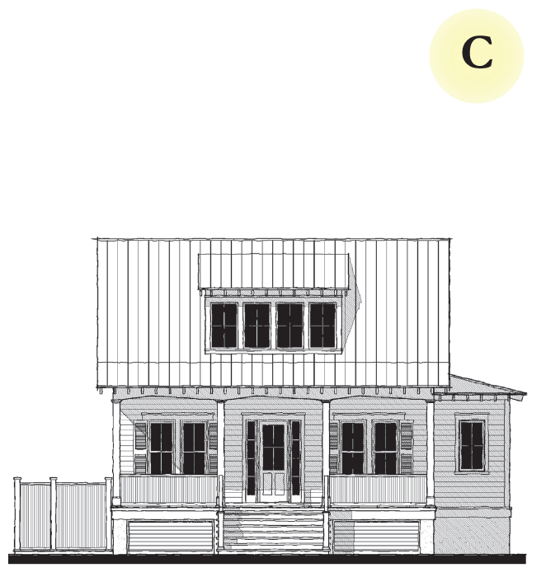
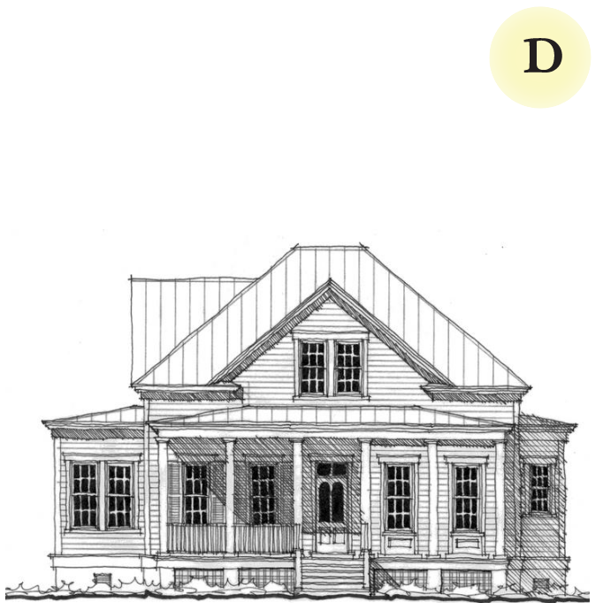
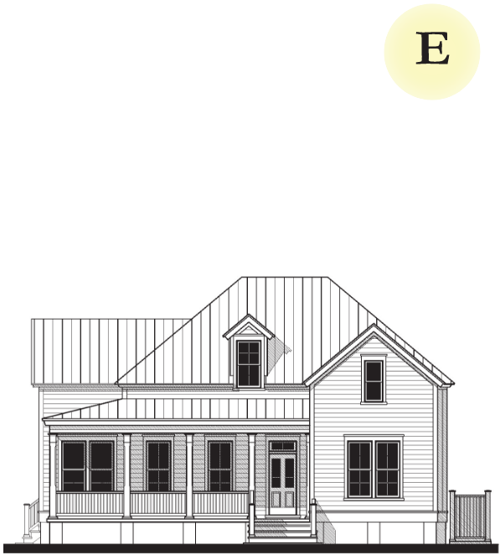
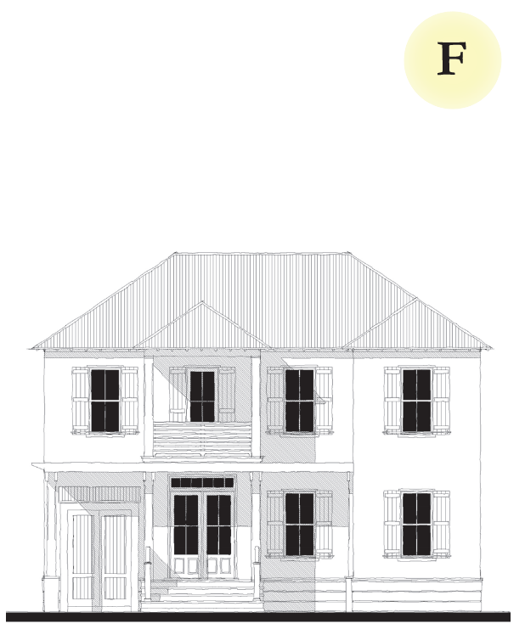

Slide 13
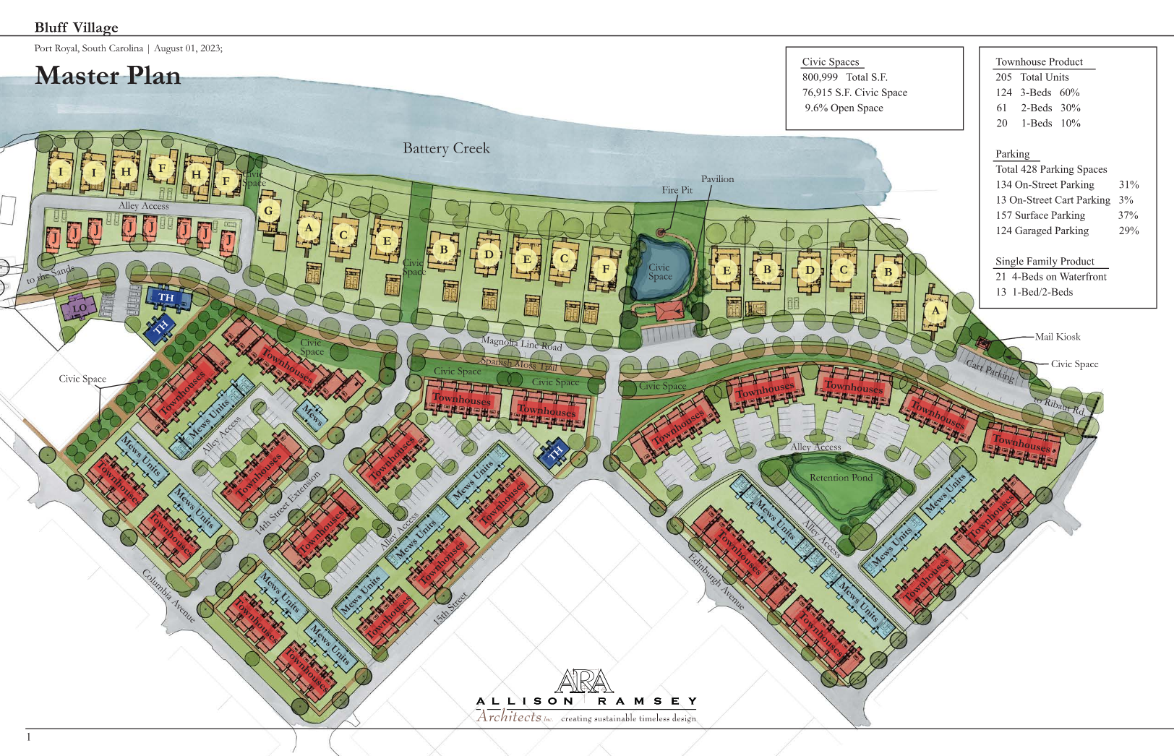

Slide 14
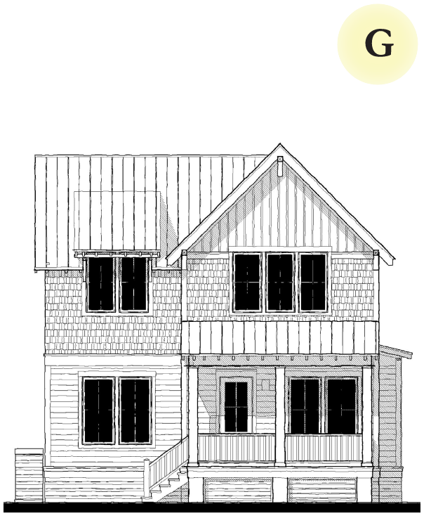
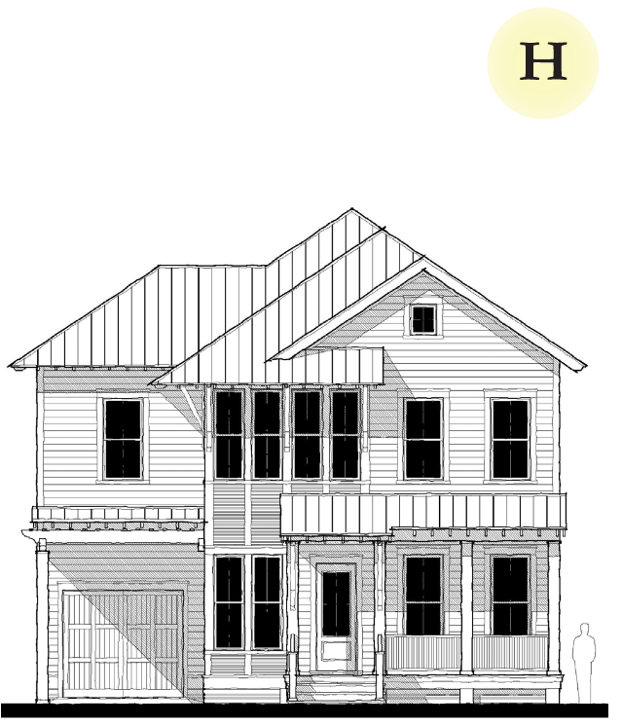
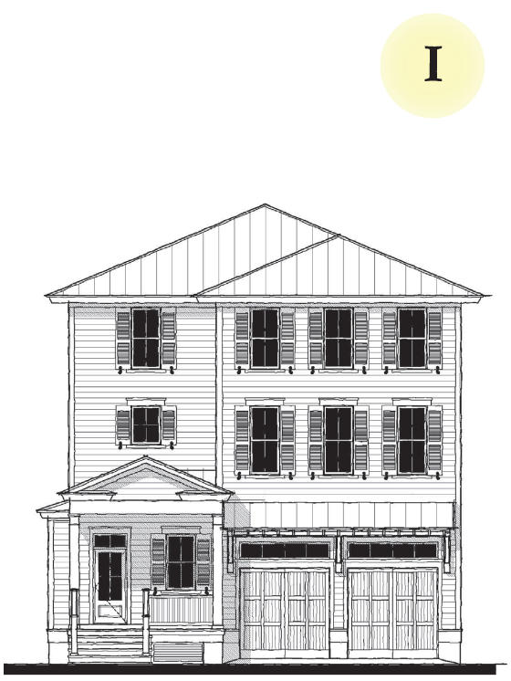
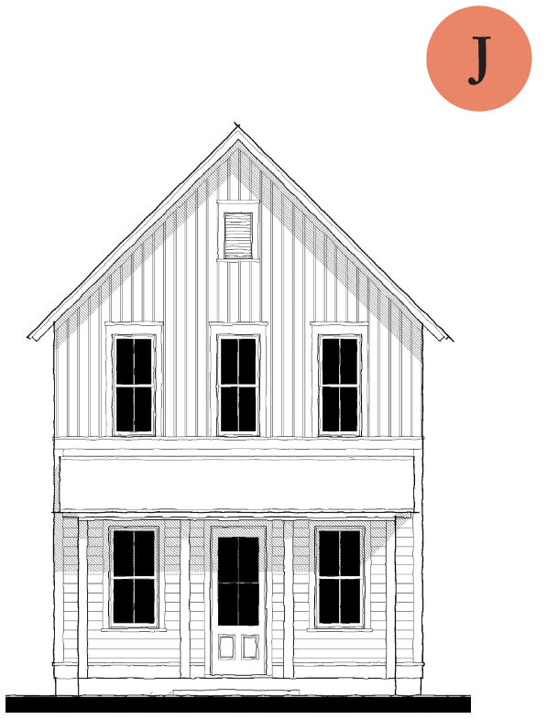
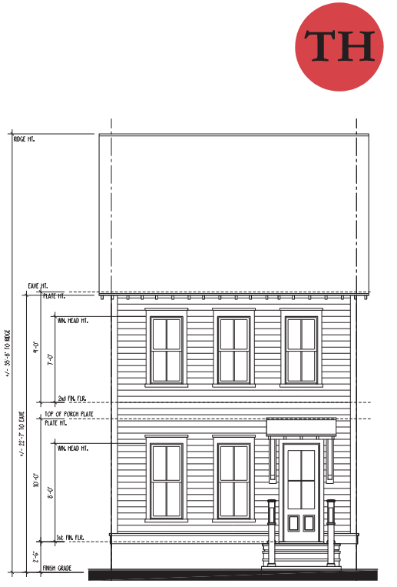
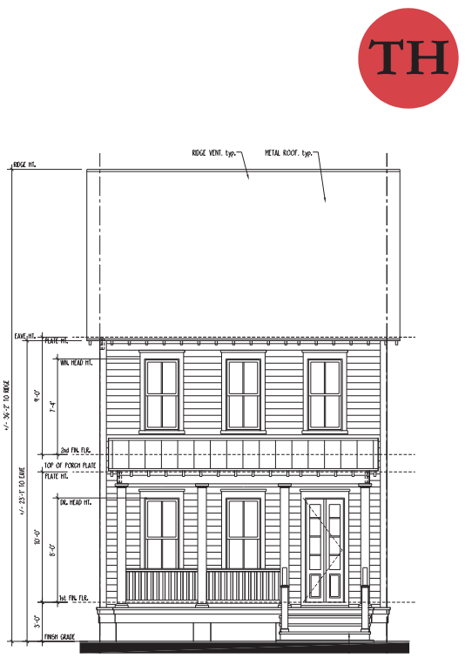

Slide 15
